Slide 1

BUILD–A-BOT

Slide 2
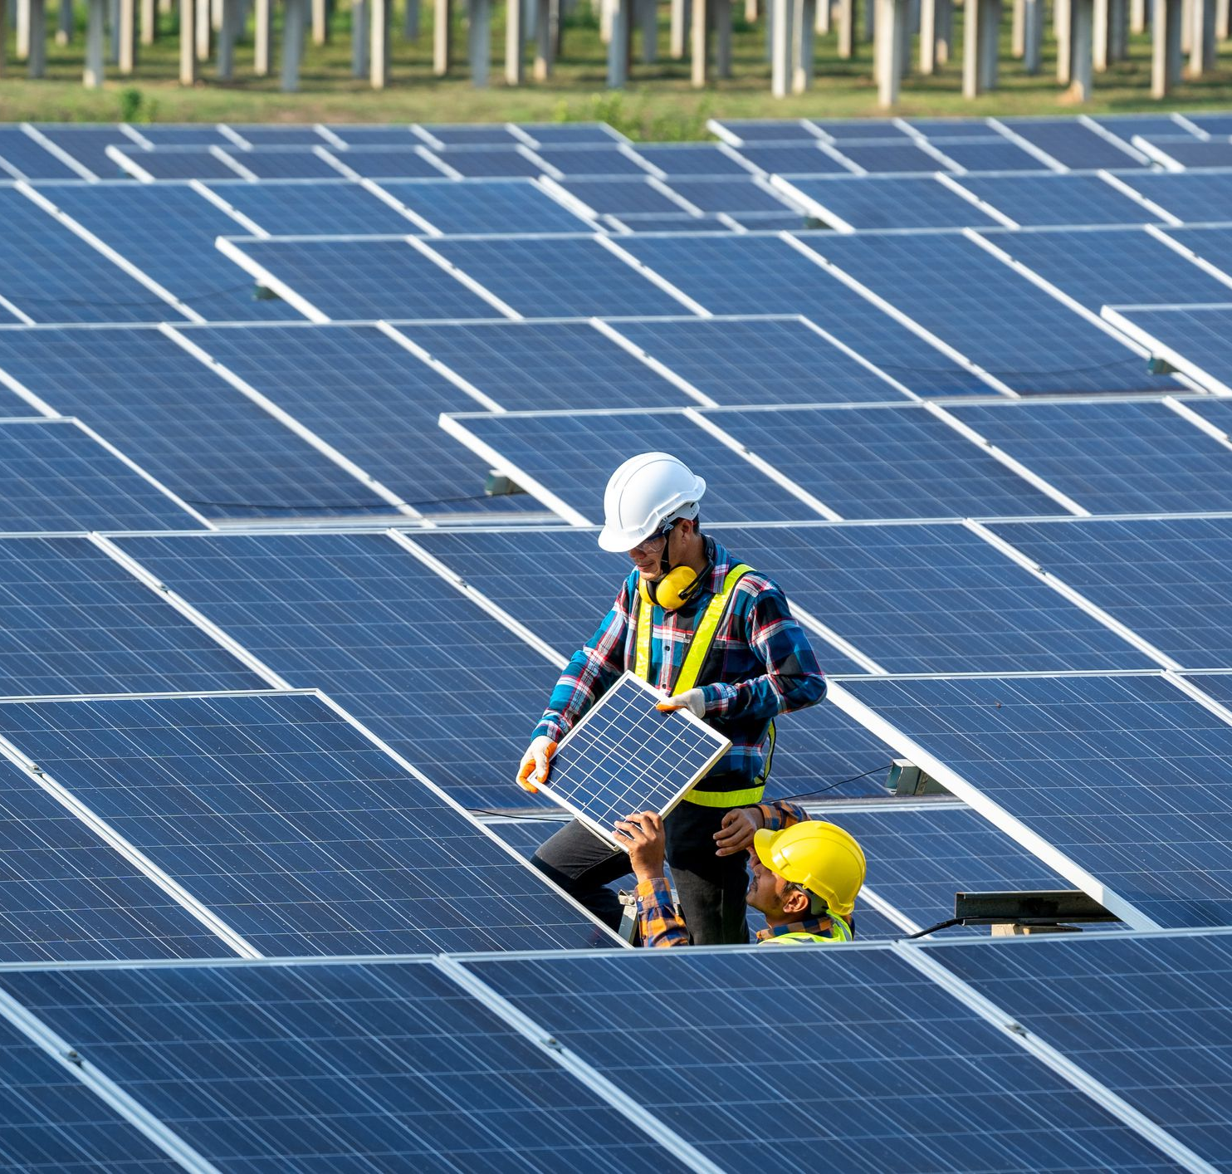
Solar power
Solar power is the direct conversion of renewable energy from sunshine into electricity via photovoltaics (PV), indirect conversion via concentrated solar power, or a combination of the two. Concentrated solar power systems focus a wide area of sunlight into a narrow beam using lenses or mirrors and solar tracking equipment. Using the photovoltaic effect, photovoltaic cells convert light into an electric current.

Slide 3

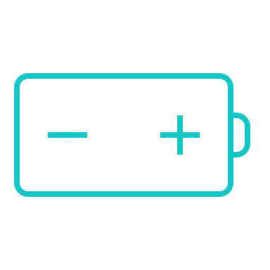

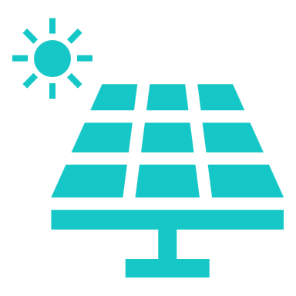
Some facts
Other sources
potential
Eco friendly
Easy to harness
The quantity of solar energy reaching the planet's surface is so large that it is almost twice as much as will ever be generated from all of the Earth's non-renewable resources of coal, oil, natural gas, and mined uranium combined in one year.
Every second, the sun produces enough energy to provide the earth with power for 500,000 years
Solar energy users save up to 35 tons of carbon dioxide and 75 million barrels of oil each year
In comparison to other sources, solar energy is fairly simple to harness.

Slide 4
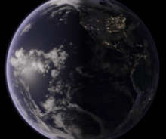
Our problem
We cannot harness the complete electricity that reaches the solar panel owing to the rotation of the planet

Slide 5
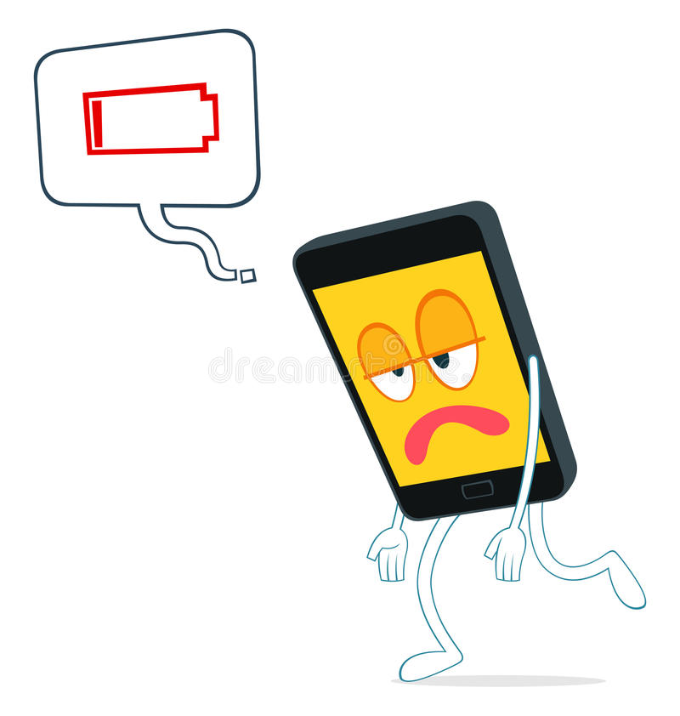
losses
Power loss
Less pollution
According to the estimates, solar energy has a worldwide potential of 1,600 to 49,800 exajoules (4.41014 to 1.41016 kWh) every year. While we only produce 844TWh every year.
We can reduce pollution by employing more solar electricity, making the planet a better place.
Financials
As a solar plant has been operating for several years, it is a one-time investment that reduces the cost of power.

Slide 6
Solution
Our approach
Now, our approach is to align a solar panel with sunlight such that it is pointing in the direction of maximum intensity light (respond like a sunflower). With the help of simple circuit and components like servo motor and LDR’s, we have designed our model to implement this.
Cost savings
Easy to use
Our machine is now constructed of inexpensive and readily accessible components and may be used again.
Writing a simple code and connecting wires correctly once ,that all we need to operate it.

Slide 7

idea
Detailed Approach
Our approach is to rotate the solar panel with the sunlight so that its surface is perpendicular to light rays. Our bot will be made up of a microcontroller (arduino), a servo, and some photoresistors. Our photoresistor will measure light intensity and send data to Arduino, which will use code and data sent by them to judge which direction has the most light and send a signal to the servo to rotate the panel in that direction.
A single controller may be connected to several servos, reducing the requirement for individual machenism for each panel; instead, we just need a few servos to perform the job.

Slide 8

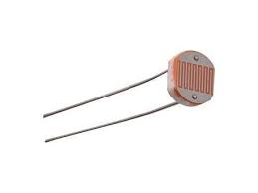
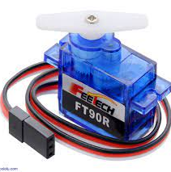
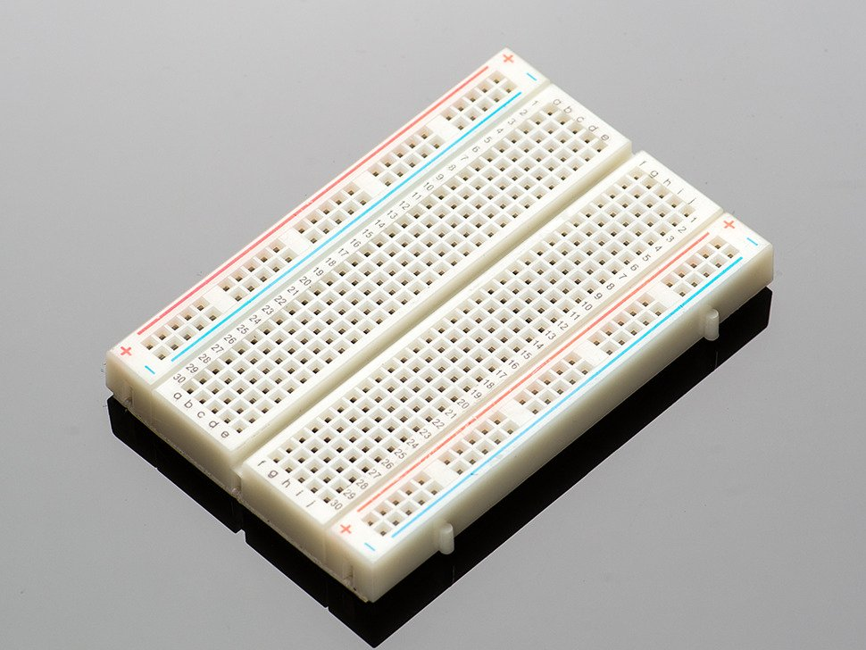
Components used
Arduino​​
photoresistor​​
servo​​
breadboard

Slide 9
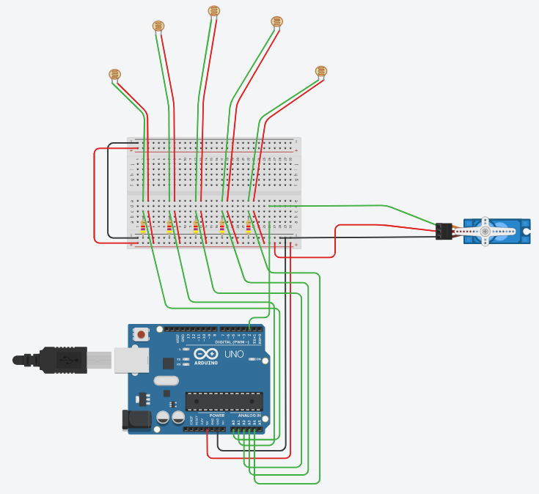
CIRCUIT
GitHub Repo Link :
https://github.com/pushkar-dev/SunFlower

Slide 10
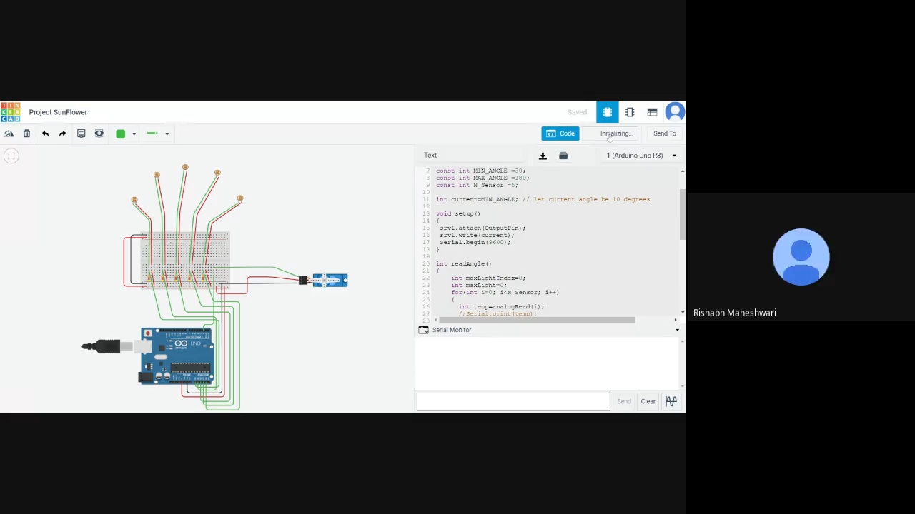
Working of circuit

Slide 11
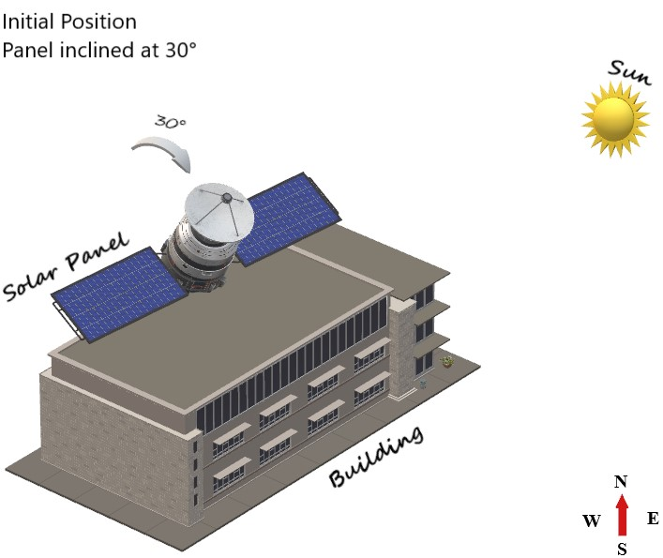
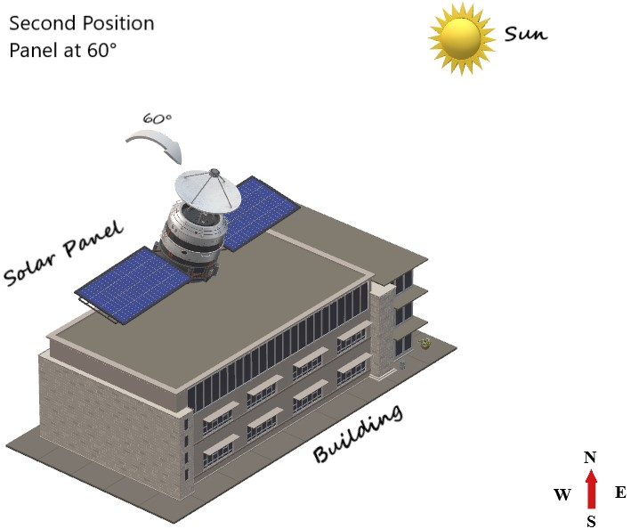
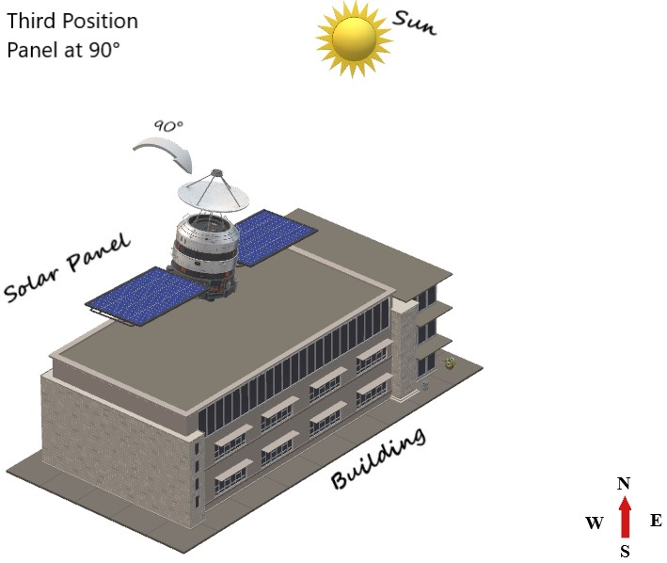
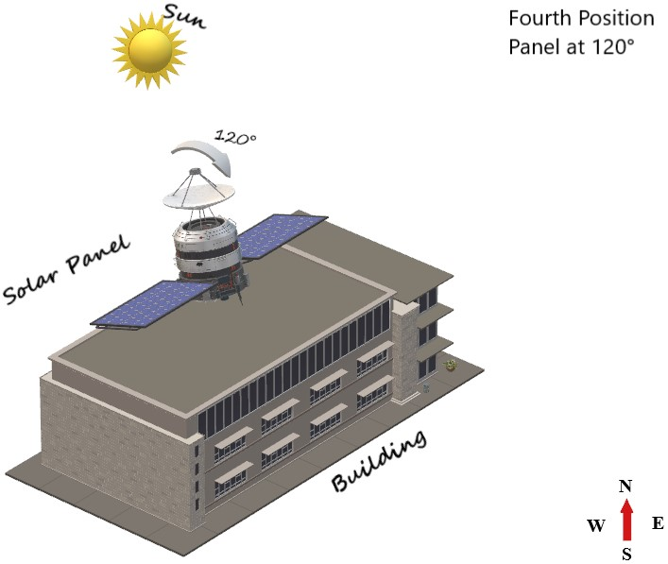
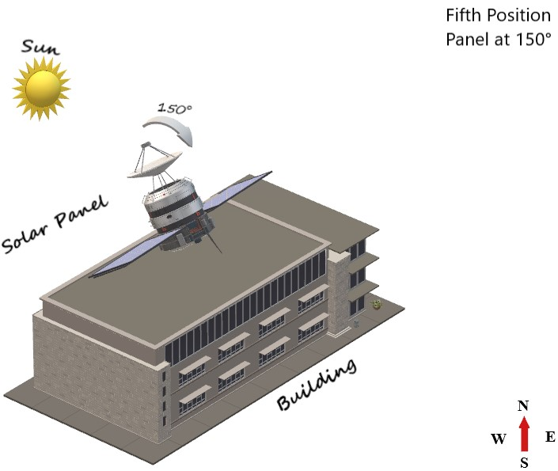
Practical model

Slide 12

Future Modification
Advanced Approach
In our model, we tried to tackle the problem due to rotation of earth, but what about revolution of earth ?
To solve the difficulties arising due to both of these phenomenon, we can add a new servo motor which can control the motion of solar panel in another axis. So, the model would be working with first servo controlling motion in X-Y Plane and second servo controlling motion in X-Z Plane. This new version V2 would require the same components as the previous model and the circuit and logic could be easily reproduced to implement this easily.
We have included a sneak peek for this version in the next slide (this version can be implemented after success of first version).

Slide 13
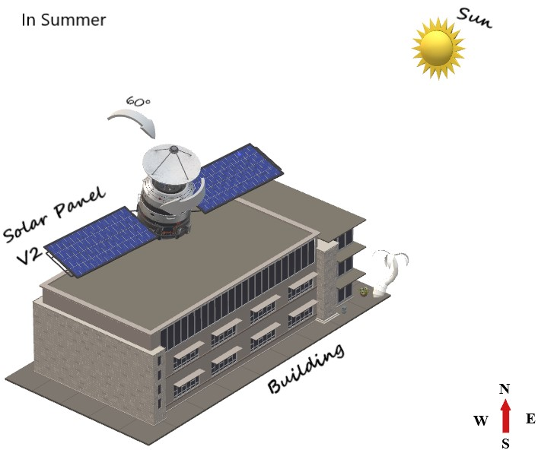
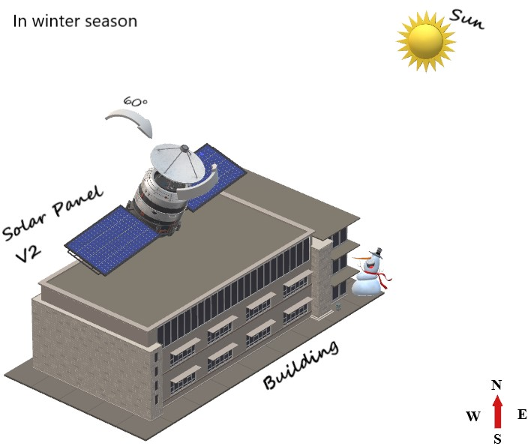
Model for V2

Slide 14

SUMMARY
Our model uses LDR’s and a servo motor to implement a rotating solar panel which can be easily installed on rooftops, and it absorbs most of the sunlight available throughout the day and converts it into energy minimizing the losses due to natural phenomenon of earth like rotation and revolution.

Slide 15

THE TEAM
Rishabh Maheshwari B20063
Nikhil Singh Ujjawal B20056
Pushkar Patel B20121
Chandresh Soni B20284
Saransh Duharia B21021

Slide 16

Thank you
Team Noob Mechatrons

